Slide 1


Green Pace
Security Policy Presentation
Developer: Ryne Williams
Notes:
This presentation is to introduce the new security policy for Green Pace. We will discuss the new coding standards that we will be implementing into the development process, as well as the automation, tools, risks and benefits, and recommendations posed by this security policy.

Slide 2

OVERVIEW: DEFENSE IN DEPTH
This security policy is designed to create a Defense in Depth framework to aid in creating secure code that is free from flaws and vulnerabilities to a reasonable extent. It will create an environment that focuses on software security from the beginning of the development process. This security policy is necessary to ensuring that sensitive data and information used in databases and applications developed are as secure as feasibly possible.
Notes:
This security policy aims to develop a “Defense in Depth” framework aimed at increasing the security and quality of the code developed by Green Pace, free from vulnerabilities and flaws to a reasonable extent. This policy will help to ensure the safety and security of user data and sensitive information by implementing varying security coding standards into the development process.

Slide 3
THREATS MATRIX
This threat matrix was populated using the data from the security policy regarding the likelihood of occurrence and the priority in which they must be dealt with if they were to occur. This data was retrieved from the Secure Coding Standards from the Carnegie Mellon University Website.
Likely ERR-051-CPP EXP-053-CPP IDS-000-J MEM-051-CPP STR-050-CPP STR-052-CPP | Priority EXP-053-CPP IDS-000-J MEM-051-CPP STR-050-CPP
Low priority CON-054-CPP DCL-003-C ERR-051-CPP INT-0540-CPP OOP-053-CPP STR-052-CPP | Unlikely CON-054-CPP DCL-003-C INT-050-CPP OOP-053-CPP
Notes:
This is a threat matrix that can help to illustrate the priority and likelihood of occurrence for vulnerabilities that this security policy aims to mitigate. The first high priority standard states that uninitialized memory should not be read. The second states that SQL Injection should be prevented. This is one of the most common forms of attacks and should be actively mitigated at all costs. The second standard states that all dynamically allocated resources should be properly deallocated. This will help with memory consumption and minimize memory leaks. The final high priority standard states that input data should always be validated. This is primarily to prevent varying forms of buffer overflow, another common form of attack from hackers. All these high priority items are likely to occur in standard coding practices and should be mitigated as much as possible. The list of low priority standards consists of not casting out-of-range- enumeration values, using valid pointers to reference elements of “basic_string”, using static assertions to test constant expressions, handling all exceptions, writing constructor member initializers in canonical order, and wrapping functions that can spuriously wake up in a loop. While these may not happen as often or are not as detrimental, they should be carefully considered when coding projects to help mitigate vulnerabilities and flaws.

Slide 4
10 PRINCIPLES
Validate Input Data
STR- 050-CPP
IDS-000-J
ERR-051- CPP
Heed Compiler Warnings
INT-050-CPP
STR-052-CPP
EXP-053- CPP
Architect and Design for Security Policies
STR- 050-CPP
STR-052-CPP
IDS-000-J
MEM-051-CPP
ERR-051- CPP
EXP-053- CPP
Keep it Simple
INT-050-CPP
EXP-053- CPP
OOP-053- CPP
CON-054-CPP
Default Deny
Adhere to the Principle of Lease Privilege
Sanitize Data Sent to Other Systems
Practice Defense in Depth
MEM-051-CPP
DCL-003-C
ERR-051- CPP
CON-054-CPP
Use Effective Quality Assurance Techniques
STR- 050-CPP
INT-050-CPP
STR-052-CPP
MEM-051-CPP
DCL-003-C
Adopt a Secure Coding Standard
IDS-000-J
Notes:
The 10 core security principles, as defined by this policy, can be mapped to the coding standards. Validating input data relates to coding standards 1, 4, and 7. Heeding compiler warnings relates to coding standards 2, 3, and 8. Architecting and designing for security policies relates to coding standards 1, 3, 4, 5, 7, and 8. Keeping it simple relates to coding standards 2, 8, 9, and 10. Practicing defense in depth relates to coding standards 3, 5, 6, and 10. Using effective quality assurance techniques relates to coding standards 1, 2, 3, 5, and 6. And finally, adopting secure coding standards relates to secure coding standard 4.

Slide 5
CODING STANDARDS
IDS-000-J (P18)
SQL Injections are one of the most common forms of attack used by hackers. This vulnerability must be checked for and corrected in all code.
STR- 050-CPP (P18)
Not checking the length of input data can lead to buffer overflows. This is one of the most common, and simplest forms of attacks used by hackers.
MEM-051-CPP (P18)
Dynamically allocated resources that are not properly deallocated can lead to an exploit that hackers can use to infiltrate a system.
EXP-053- CPP (P12)
It is important to initialize all variables to ensure that unexpected behavior is kept to a minimum.
STR-052-CPP (P6)
Ensuring that references and pointers to elements of basic_string reduces the likelihood of a program crash or bug.
ERR-051- CPP (P4)
Exceptions can cause a program to crash or allow for vulnerabilities that hackers can exploit. It is important to handle all exceptions, within reason.
INT-050-CPP (P4)
It is important to check that a cast is not to an out-of-range value in an enumeration value, otherwise the application may crash.
OOP-053- CPP (P4)
Declaring variables in the order in which they are assigned values in a function help to keep unspecified values from being assigned to variables, keeping bugs and unexpected behavior to a minimum.
CON-054-CPP (P2)
Wrapping functions that can be woken up in a loop spuriously or maliciously will prevent it from entering a loop prematurely.
DCL-003-C (P1)
The use of a runtime assertion is better than nothing. However, static assertions for constant expressions allow incorrect assertions to be diagnosed at compile time.
Notes:
Here we see the coding standards and their priority in respect to one another. The coding standards related to preventing SQL Injections, validating input data, resource deallocation, and variable initialization are of the top priority items in this policy. While the rest of the coding standards including “basic_string” references, exception handling, out-of-range enumeration casting, constructor member initialization order, function wrapping, and static assertions are not as high on the priority list, they should still be carefully considered when developing code.

Slide 6
ENCRYPTION POLICIES
Encryption at Rest - This type of encryption is used when data is being stored, whether on a disk drive or in a database. It should be used when storing data on servers or in databases by using symmetric encryption.
Encryption in Flight - This type of encryption is used for data that is in transit. It should be used when sending or receiving data, whether over wired or wireless networks, using Secure Socket Layer level encryption.
Encryption in Use - This type of encryption is used when data is being actively used, it also helps with analyzing data requests and denies access to unauthorized users. This type of encryption would be used when users are using data for analysis or to perform their work tasks by using homomorphic encryption.
Notes:
Here we define our encryption policies. Encryption at rest is a type of encryption used for data that has been stored on a disk drive or database. This type of data is usually encrypted using symmetric encryption algorithms. Encryption in flight is a type of encryption for data that is in transit to or from a server, database, or user. This type of data is best secured using SSL (Secure Socket Layer) encryption algorithms. Finally, encryption in use is when data is being used by a user, system, or algorithm to process or manipulate the data. Data in this state should be encrypted using a homomorphic encryption algorithm.

Slide 7
TRIPLE-A POLICIES
Authentication – Authentication is used to verify that a user has been granted access to the system in use, using user IDs and passwords. This keeps unwanted and unauthorized users from accessing sensitive data within the system.
Authorization – Authorization is the level of access that each authorized user has in the system. This should follow the principle of least privilege to ensure that no one can access data that has no direct need of it. This will help to ensure that authorized users cannot make changes to data or databases and that no user without proper authorization can add or remove other users.
Accounting - Accounting is the act of monitoring the usage of data and the level of authorization that other users have within the system. It is important to keep an accurate account of who is using the system, what they are using it for, and when they access the system. This can help to mitigate intrusions, as well as quickly find where an unauthorized access occurred.
Notes:
Triple-A policies are set in place to help secure the use of data and functions of the system. Authentication relates to verifying that a user has access to the system. This includes usernames, emails, passwords, and security questions. Authorization relates the level of access that a user has to the system. The principle of least privilege falls under this policy, and it is best to ensure that every authorized user only has access to parts of the system that they immediately need to perform their jobs. Accounting encompasses who has access to what parts of the system, as well as monitoring who accesses the system and how they use the data. This policy can help to ensure that if there is a data breach, it can be caught quickly and handled.

Slide 8
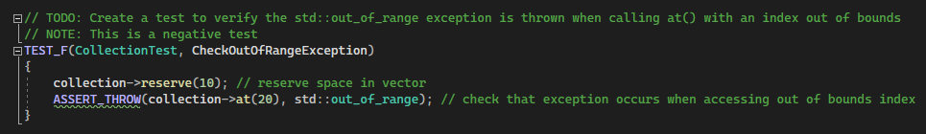
Check Out of Range Exception
This negative unit test shows how to test for proper error handling. It tests to ensure that the code will throw an error when someone attempts to access an out-of-range index in the array. This will help to mitigate the possibility of an attacker performing a buffer overflow attack on the system.
Notes:
Here we can cover some of the unit testing required to ensure the proper implementation of these coding standards. The first unit test is for an out-of-range exception test. This test displays how to check for values being inputted into a vector that does not have enough memory to hold the data.

Slide 9
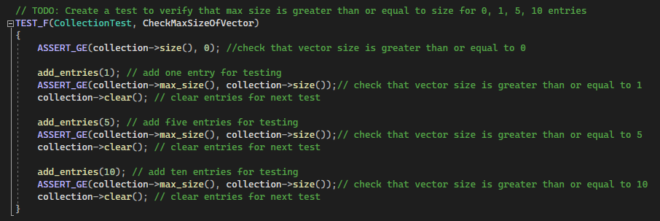
Check Max Size of Vector
This positive unit test checks that the maximum size of the vector is greater than the potential number of indices needed for the data to be held. It will check at multiple different index sizes to ensure that the vector can hold all data entries. This will help to mitigate the chances of the application crashing and an attacker gaining access to sensitive data.
Notes:
The next unit test is to check the max size of a vector. This test outlines how to check that the max size of the vector changes with calls to add entries to the vector.

Slide 10
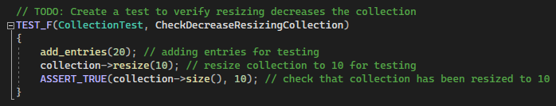
Check Decrease Resizing Collection
This positive unit test checks that resizing the memory for the vector is successful. It will ensure that unused memory is removed from the vector. This will help to prevent vulnerabilities such as memory leaks and free up space in memory for other processes.
Notes:
Next, we cover a unit test for checking that a vector resizing decreases the size of the vector. This test adds entries to the vector, resizes the vector, and then checks that the max size of the vector has been changed.

Slide 11
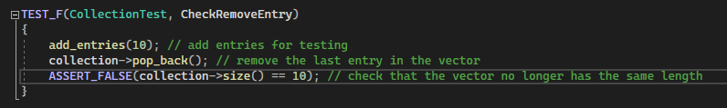
Check Remove Entry
This negative unit test checks that data is removed from the vector. This will ensure that the vector does not contain old data that is no longer needed or used and prevents unintended stack smashing caused by an unknown amount of data being left behind.
Notes:
. The final unit test in this presentation checks that entries are removed properly from the vector. This negative test will remove an entry and test to ensure that the entry has been removed from the vector.

Slide 12

AUTOMATION SUMMARY
Automation should take place in the “Verify and Test” phase of the DevSecOps process. This will allow it to speed up the testing process, as well as fit into the natural process of compliancy and security testing. Also, this is the phase at which automation should be the least intrusive when adding it into the process, to minimize the need for a transition period to ensure that there is no confusion and fewer mistakes are made from adding in new steps to the process.
We could also introduce Security Automation into the “Build” phase of the DevSecOps process. This will allow for code to be tested as it is being developed and will help developers to reinforce a security focused mindset when developing code for an application. This may be a bit more intrusive to the process than the “Verify and Test” phase. However, it will prove to speed up both processes by finding vulnerabilities as the code is being built.
Notes:
Automating security and quality in the DevSecOps pipeline is important to the success of a new security policy. To properly automate security and quality, it is necessary to implement automation in the proper place in the DevSecOps pipeline. Implementing automation in the “Verify and Test” phase will allow for the new policies to have the least amount of impact on the development process and can help to push focus on security on the testing team and the developers as the results trickle down to the development team. We can also implement automation in the “Build” phase of the pipeline to help ensure focus on security at the beginning of the development process, allowing it to be more of a focus on subsequent phases.

Slide 13
TOOLS
The DevSecOps pipeline is a CI/CD (Continuous Integration/ Continuous Delivery) methodology that aims to make security one of the primary focuses of the software development process. It builds on the DevOps pipeline, that takes security into account; however, security is seen more as a secondary system than a primary focus. The DevSecOps pipeline aims to fix this oversight in a category that is the most important to keeping data secure.
IDE plugins are used during the development process to help identify errors and bugs in code. SAST (Static Application Security Testing) is used during the testing process to scan source code for known flaws and vulnerabilities. Docker file scanning is performed in the build process to find misconfigurations. Compliance checks are performed during deployment as an auditing standard.
Notes:
The DevSecOps pipeline is a build on a CI/CD methodology that aims to increase the focus of security in all aspects of the software development process. Utilizing IDE plugins in the development process helps to identify syntax errors and bugs in code. Static Application Security Testing is an important tool in the testing process to scan the source code for known vulnerabilities that may have been missed. Docker file scanning in the build process helps to illustrate misconfigurations that need to be addressed. Finally, compliance checks during deployment help to ensure the continued operation of a system as an auditing standard.

Slide 14
RISKS AND BENEFITS
Acting on security policies now would pose some problems, most of which is the problem of introducing substantial change to the culture. There is also the issue of the cost of implementing change in an already established process. However, the benefits from such a change would counteract such drawbacks almost immediately. For example, the amount of money saved from needing limited regression testing would be a major cost saving aspect. It would also save money from having to go back through code to fix flaws and vulnerabilities.
While the cost of waiting to implement security policies would seem to be cheaper up front. The costs would begin to pile up after the testing phase when code is sent back to be reworked and then put through regression testing. It would also seem to be a benefit to wait to reduce the amount of pushback from developers due to a major change in the process and culture. However, issues would begin to arise when a large amount of man hours are required to go back over code, leading to more stress and frustration in the development team.
Notes:
While there may be some short-term risks included in an immediate major culture change, this change is vital to combatting the ongoing security threats that plague the digital world. There may be some push back to new processes, tools, and requirements added to a developer’s job, as well as some overhead involved in training developers on these new processes. However, the money saved on reviewing and fixing code will make these risks worth it. There are also some risks in waiting until later to implement new security standards. Waiting until later to implement these new security standards opens the company up to security threats that put the company at risk. This can cost the company money in regression testing and increased hours needed to find and fix the issues that led to an attack from a hacker.

Slide 15
RECOMMENDATIONS
The current security policy lacks standards to prevent SQL Injections, buffer overflows, and memory leaks in certain code. These vulnerabilities are the most important to guard against, as they pose the highest threat to security. Adopting the coding standards related to these vulnerabilities will help to mitigate this.
The current security policy also lacks standards to guard against known issues that can cause unexpected behavior in programs, which can likely lead to crashing applications, unintended values in memory, or code blocks spuriously waking up in a loop. These are not necessarily detrimental to data security but can pose a threat to the security of data in applications and should be handled properly.
The current security policy lacks standards that can assist in keeping code simple, clean, and organized. This is important to help with finding bugs and flaws that need to be addressed, whether during development, in testing, or in correcting missed bugs and vulnerabilities. Implementing these standards can help to speed up the development process, as well as cut cost in refactoring and reworking code to fix these issues.
Notes:
It is recommended that we implement the standards with a higher priority immediately to mitigate any chances of attack from hackers. The current security policy is lacking in standards to handle such issues, were they to arise. It also lacks safeguards for issues that can cause unexpected behavior or program crashes. There is also no known policy that can help keep the code being developed simple and organized for easier maintenance. It is recommended that we implement the standards to fix these issues over time to allow for developers to adapt to each new standard, without overwhelming the entire team.

Slide 16
CONCLUSIONS
Standards EXP-053-CPP, IDS-000-J, MEM-051-CPP, STR-050-CPP, and STR-052-CPP are the most important standards to implement immediately as they pose risks to attacks by hackers and can allow them to infiltrate the system and access sensitive data. Implementing these will help to improve code security immediately and will increase the quality of the code created.
Standards CON-054-CPP, DCL-003-C, ERR-051-CPP, INT-050-CPP, and OOP-053-CPP are not as pressing to the security of the code and can be integrated more slowly. However, it is important to get these standards implemented in a timely manner to further increase the quality and security of the code being developed.
Notes:
Standards related to validating input data, preventing SQL Injection, exception handling, memory deallocation, and referencing “basic_string” are of the highest priority and should be implemented immediately to ensure that code being developed is of an adequate security level to ensure that attacks are mitigated to a reasonable level. The rest of the standards, while not as important, should still be implemented to ensure that code is easier to maintain and manage after deployment. These can be implemented slowly, adding a new standard to implementation every week or two to minimize culture shock to the teams.

Slide 17
REFERENCES
Bhandari, P., (2023), DevSecOps pipeline: A complete overview, Xenonstack, Retrieved from: https://www.xenonstack.com/insights/guide-devsecops-pipeline
Dinic, M., (2022), A complete guide to encryption: Data at rest, data in motion, and data in use, Jatheon, Retrieved from: https://jatheon.com/blog/data-at-rest-data-in-motion-data-in-use/
Magnusson, A., (2023), What is AAA security? Authentication, authorization, and accounting, Strong DM, Retrieved from: https://www.strongdm.com/blog/aaa-security
Milviya, N., (2022), Understanding the DevSecOps pipeline, Infosec, Retrieved from: https://resources.infosecinstitute.com/topics/application-security/understanding-the-devsecops-pipeline/
Seacord, R., (2012), Secure coding in C++ (2nd ed.), Addison-Wesley, https://mbsdirect.vitalsource.com/reader/books/9780132981972/epubcfi/6/4[%3Bvnd.vst.idref%3Dtitle]!/4/10/1:29[ost%2Con%20]
Watts, S., (2023), What is security automation, Splunk, Retrieved from: https://www.splunk.com/en_us/blog/learn/security-automation.html
Notes:
Here are some resources for you to view if you have any questions or wish for more details regarding these security coding standards, the DevSecOps pipeline, unit testing, automation, encryption or Triple-A policies.

